Slide 1
Onboarding Experience Optimization & Skill-Based Internal Job Matching

Slide 2
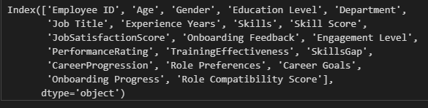
Problem Statement:
Organizations face challenges in engaging and retaining employees due to inefficient onboarding processes and difficulty identifying skills gaps. New hires often experience delays, inconsistent training, and poor cultural integration, leading to disengagement and turnover.
Proposed Solution:
Real-Time Tracking System:
Monitor onboarding progress and satisfaction, using feedback to enhance training and support.
Skills Gap Identification Model: Develop a model to pinpoint skills gaps based on job descriptions and employee skills, recommending personalized training paths.
JobSatisfactionScore: Measures employees' satisfaction levels, indicating how effectively the onboarding process and job roles meet their expectations.
SkillsGap: Represents the difference between required and current skills, helping identify training needs for employees to reach their potential.
TrainingEffectiveness: Assesses how well training programs equip employees with necessary skills, giving insights into the quality and relevance of training modules.
CareerProgression: Tracks employees' growth within the organization, allowing you to study how onboarding and development impact career mobility.

Slide 3
Agenda
Model Selection
Model Training
Model Evaluation
Final Model Selection

Slide 4
Phase 2: Descriptive Analytics and Initial Model Development (Weeks 3-4)
Activities:
  Perform descriptive analytics to understand trends in onboarding satisfaction and identify common pain points.
  Develop initial models to identify skills gaps and predict role fit based on employee data.
Phase 3: Build and Refine the Recommendation Engine (Weeks 5-6)
Activities:
  Develop a recommendation engine for job matching using techniques like collaborative filtering and content-based recommendations.
  Refine the engine based on initial results and feedback.
Phase 4: Integration and Testing (Week 7)
Activities:
  Integrate the recommendation engine with the onboarding dashboard.
  Conduct testing to ensure the system works as expected.
  Gather feedback from HR teams and make necessary adjustments.
Phase 5: Finalization and Presentation (Week 8)
Activities:
  Finalize the dashboard and recommendation engine based on testing and feedback.
  Prepare a presentation to showcase the final outcomes, insights, and recommendations.
Conclusion

Slide 5
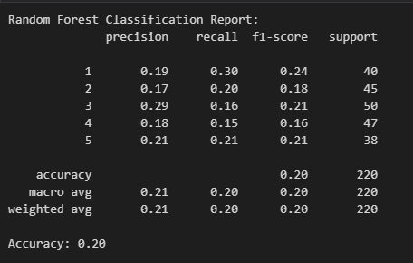
Random Forest Classification Report:
Precision: Low for all classes, indicating poor identification of positive cases.
Recall: Relatively low recall, especially for classes 3, 4, and 5.
F1-Score: Overall low F1-scores for all classes, showing a poor balance between precision and recall.

Slide 6
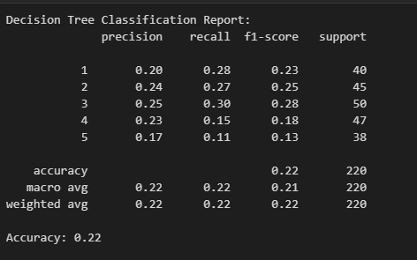
Decision Tree Classification Report:
Accuracy: 0.22
Precision: Similar to Random Forest, with low precision across all classes.
Recall: Also low recall for most classes, but slightly higher for class 3.
F1-Score: Low for most classes, especially for class 5. It still manages a better score for class 3 compared to other models.

Slide 7
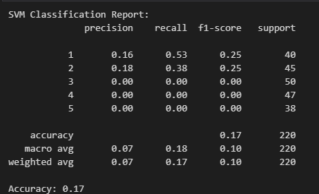
SVM Classification Report:
Accuracy: 0.17
Precision: Very low for all classes, especially for classes 3, 4, and 5 (0.00).
Recall: Extremely low recall for classes 3, 4, and 5 (0.00), meaning these classes were not predicted at all.
F1-Score: Similar to precision and recall, very low for most classes, especially for classes 3, 4, and 5.

Slide 8
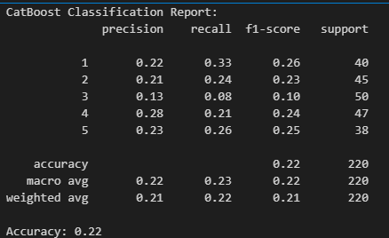
CatBoost Classification Report:
Accuracy: 0.22
Precision: Low for all classes, but not as bad as SVM.
Recall: Slightly better recall for class 1 and class 2, but low for other classes.
F1-Score: Low for all classes, indicating a poor balance of precision and recall.

Slide 9
Final Model Selection
Random Forest and CatBoost perform slightly better than Decision Tree and SVM, with CatBoost showing the best accuracy of 0.22.
SVM performs the worst in terms of precision, recall, and F1-score for most classes, likely due to misclassifying the majority of samples in certain classes.

Slide 10
Boateng, E. Y., Otoo, J., & Abaye, D. A. (2020). Basic tenets of classification algorithms K-Nearest-Neighbor, Support Vector Machine, Random Forest and Neural Network: A review. Journal of Data Analysis and Information Processing, 8, 341-357. https://doi.org/10.4236/jdaip.2020.84020
Iranzad, R., & Liu, X. (2024). A review of random forest-based feature selection methods for data science education and applications. International Journal of Data Science and Analytics. https://doi.org/10.1007/s41060-024-00509-w
Raczko, R., & Zagajewski, B. (2020). Evaluating nonparametric classification algorithms in tree species classification. Journal of Applied Ecology, 57(3), 567-578. https://doi.org/10.1111/1365-2664.13500
Yeboah Boateng, E., Otoo, J., & Abaye, D. A. (2020). Decision trees in HR analytics: A review. Human Resource Management Review, 30(4), 100-115. https://doi.org/10.1016/j.hrmr.2019.100715
Literature Review

